Slide 1
LLMs: Literature Survey
AI Seminar
November 16, 2023 (not a second later)
Luke Ross

Slide 2
Topics – June 20, 2023
Intro: LLMs and RLHF
Fine-Tuning Language Models from Human Preferences
Learning to summarize from human feedback
InstructGPT
Language Model Scaling
Chinchilla
Llama
Emergent Abilities of Large Language Models
Are Emergent Abilities of Large Language Models a Mirage?
Fine-Tuning Approaches
LoRA
Alpaca
Vicuna
LIMA: Less Is More for Alignment
Evaluation
False Promise of Imitating Proprietary LLMs
How Far Can Camels Go?
Orca
Open LLM Leaderboard
Quantization
QLoRA
SpQR
RLHF & Alternatives
Direct Preference Optimization
RL4F

Slide 3
Topics – Today (November 16, 2023)
Review: LLMs and RLHF
Fine-Tuning Language Models from Human Preferences
Learning to summarize from human feedback
InstructGPT
New Model Releases
Llama 2
Mistral 7B
Phi-1.5
Model Architecture
Mixture of Experts
Long Context
Training Recipes
Direct Preference Optimization
RLAIF
Zephyr
LLM Evaluation
Judging LLM-as-a-Judge
Rethinking Benchmark and Contamination
Augmenting LLMs
ToolLLM
Tool Use Example
Retrieval Meets Long Context LLMs
FordEncoders

Slide 4
Review: LLMs + RLHF
What’s an LLM?

Slide 5
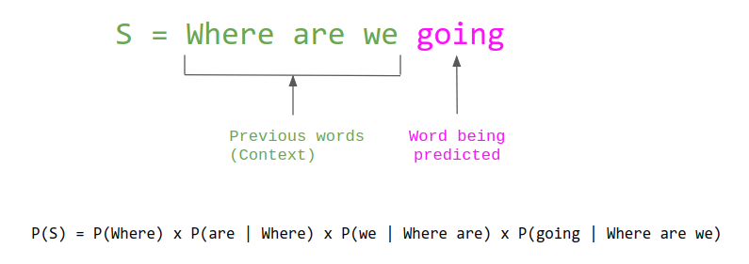
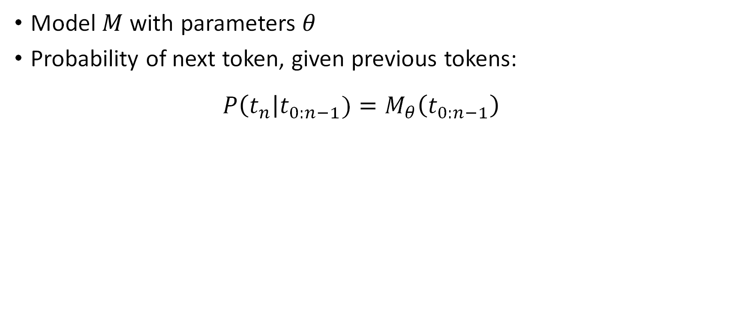
LLM: Large Language Model
Model $M$ with parameters $θ$
Probability of next token, given previous tokens:
$$P\left(t_{n}\right|t_{0:n−1})=M_{θ}\left(t_{0:n−1}\right)$$

Slide 6
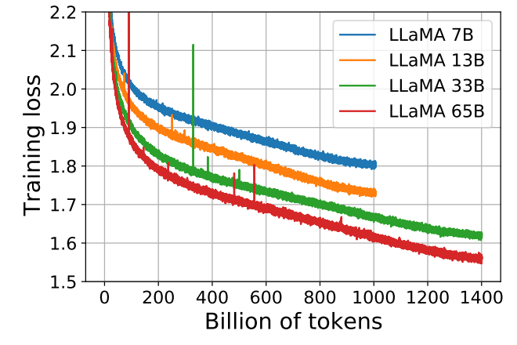
Foundation Models
Goal: learn structure of language plus general knowledge/facts
Training: next token prediction on trillions of tokens of general domain text (Wikipedia, Reddit, GitHub, etc.)
Examples:
GPT-2: 2019
GPT-3: 2020
Chinchilla: 2022
PaLM: 2022
Llama 1: 2023
Llama 2: 2023

Slide 7
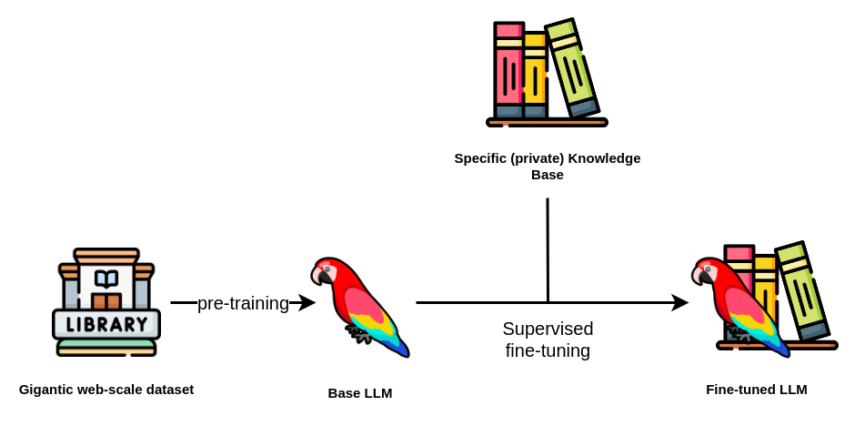
Supervised Fine-Tuning (SFT)
Pretraining:
Generic
Huge Datasets
Unlabeled Data (Unsupervised)
Computationally Expensive
SFT:
Specific (Task/Domain/Style)
Smaller Datasets
Labeled Data (Supervised)
Computationally Inexpensive

Slide 8
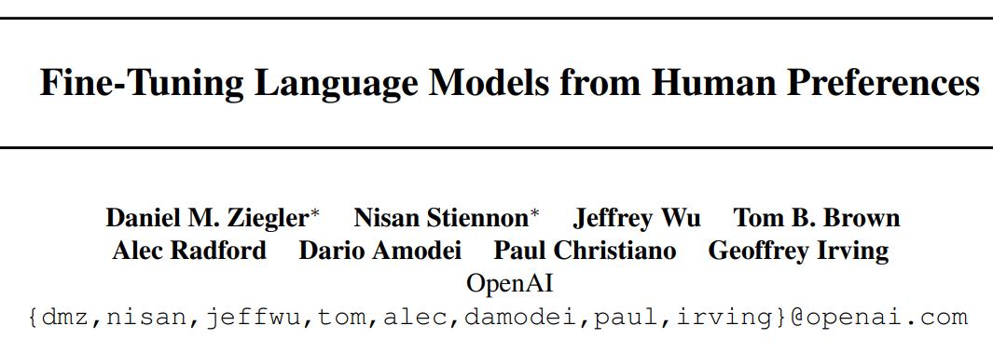
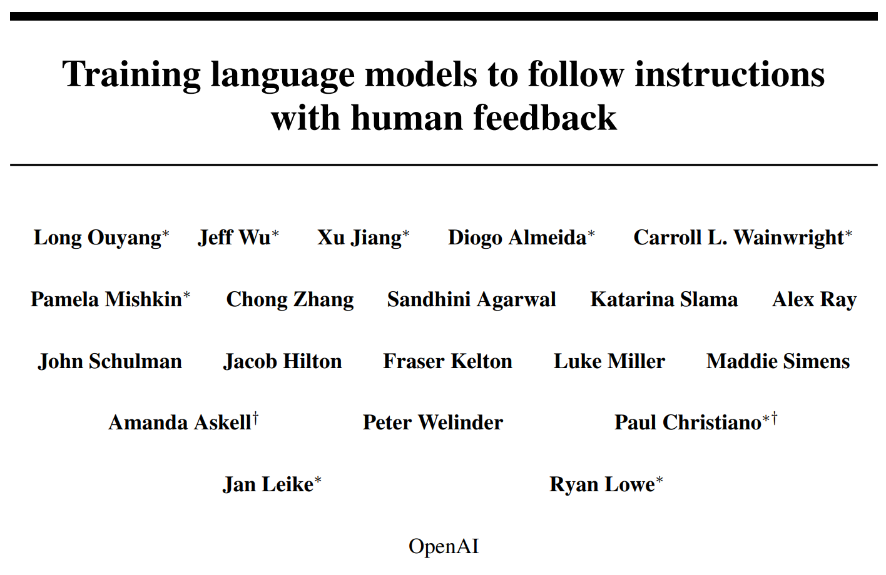
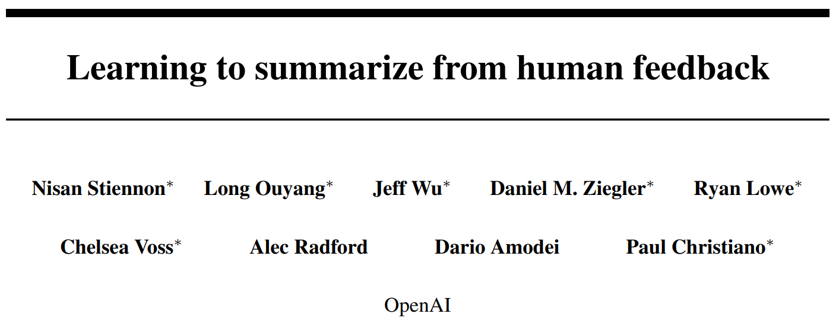
RLHF: Reinforcement Learning from Human Feedback
Initial Idea
Instruction Finetuning (~GPT3.5)
Applied to Summarization

Slide 9
RLHF - Motivation
Generative evaluation metrics are low quality
Maximum Likelihood Objective (SFT) punishes all errors the same
Hallucinations just as bad as synonym replacement
Sensitive to low quality ground truth
LM “completions” != instruction following
Solution: directly align with human preferences

Slide 10
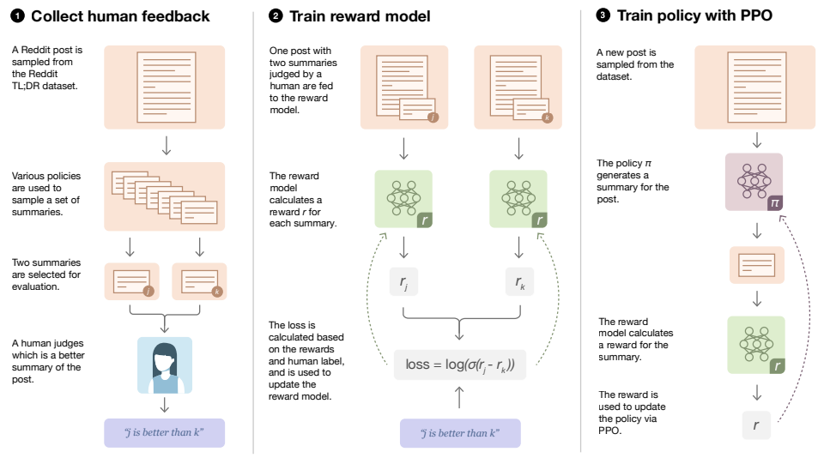
RLHF - Approach
0. Begin with a supervised model
Send output pairs to humans, who choose the better output among:
Latest RLHF model output
Initial supervised model output
Ground truth labels
Other baseline models
Train a Reward Model (RM) to predict preferred output
Train supervised model w/ RL, using RM logit score as reward

Slide 11
New Model Releases
Llama-2, Mistral 7B, and Phi-1.5

Slide 12
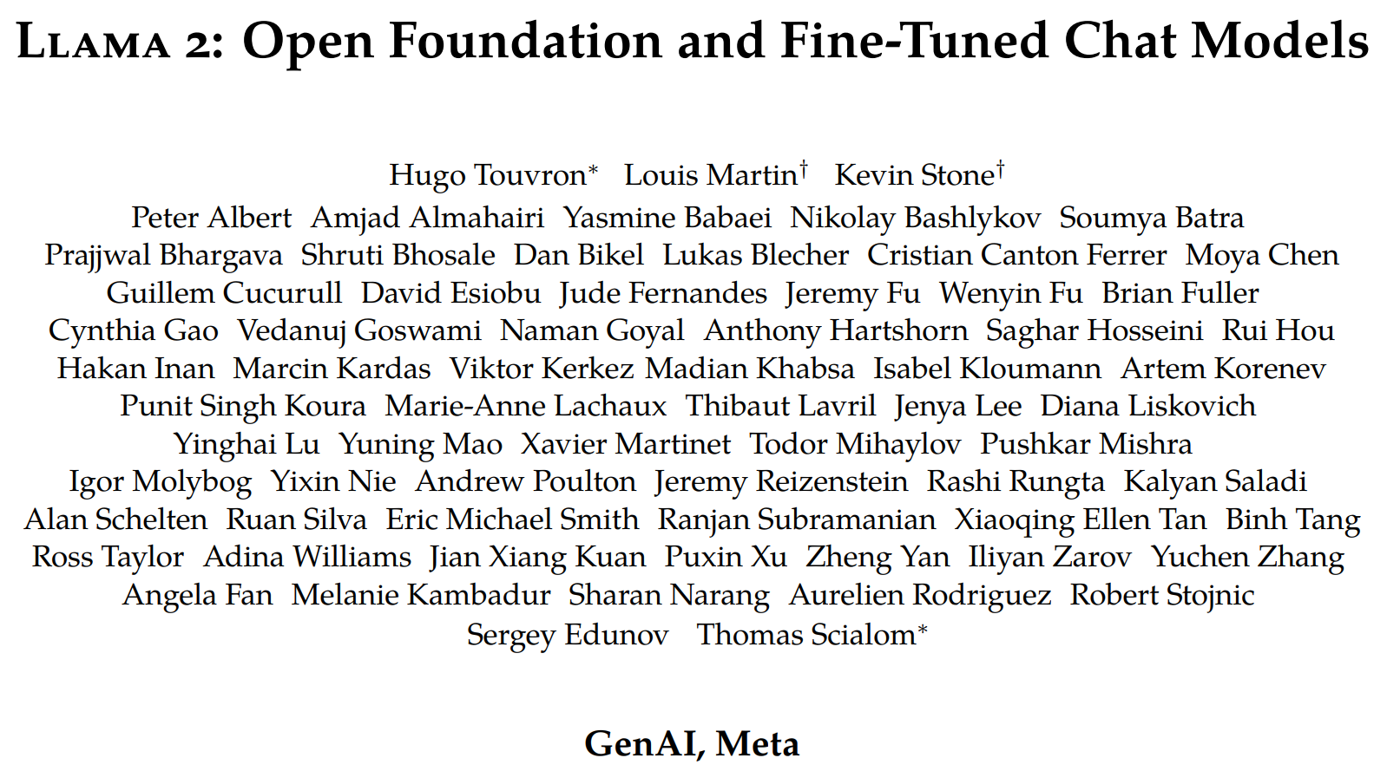
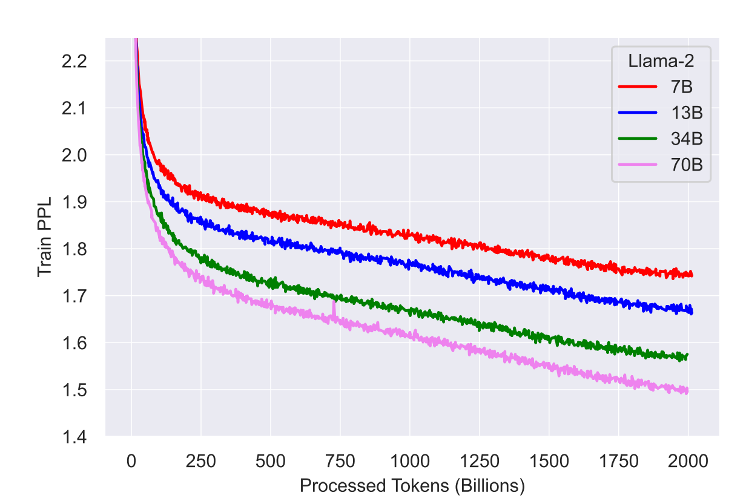
Motivation: Circa July 2023, no Open LLMs can compete with “product” LLMs like ChatGPT and PaLM
Approach:
Scale up pretraining from 1.4T → 2T tokens
Double context length from 2k → 4k tokens
Full RLHF chat model
Results:
New SOTA open LLM (July 2023)
Very detailed, reproducible paper

Slide 13
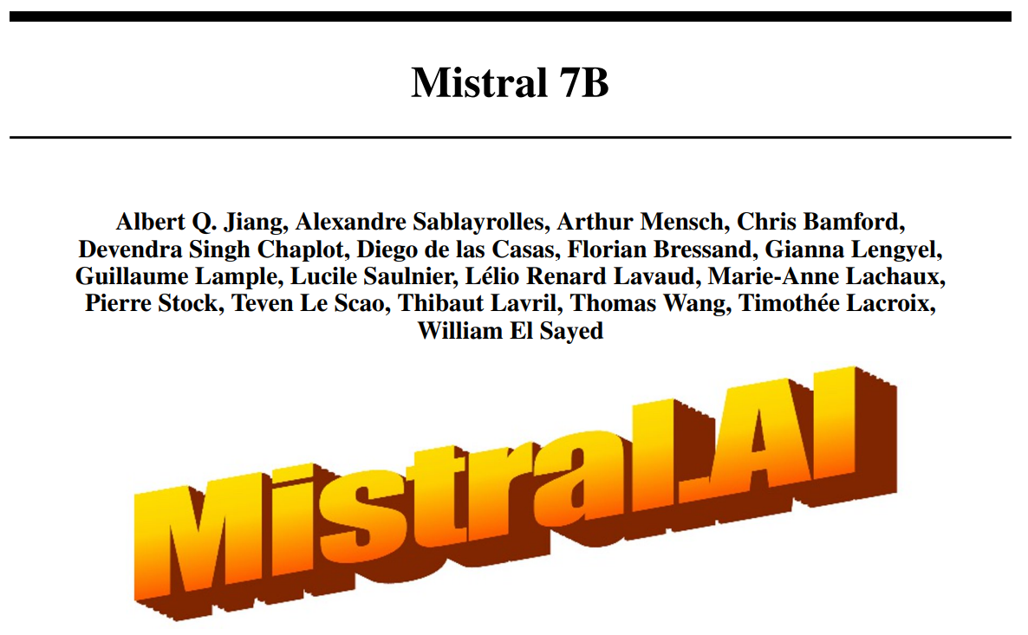
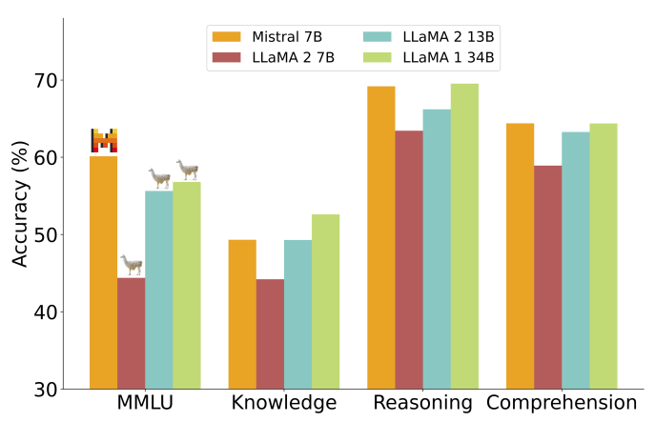
Motivation: Produce a powerful, lightweight LLM
Approach: Use some architecture tricks to improve inference speed
Results:
New SOTA model for its size (Sept 27, 2023)
Paper is basically a press release – few technical details
NOTE: limited instruction tuning

Slide 14
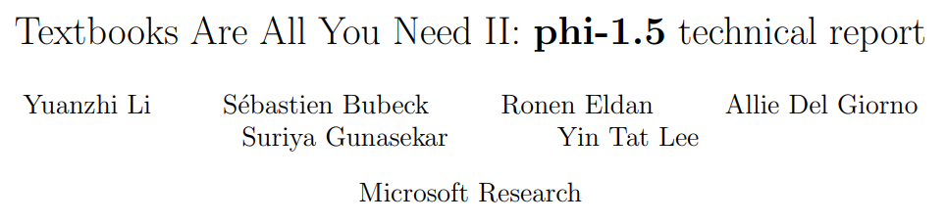
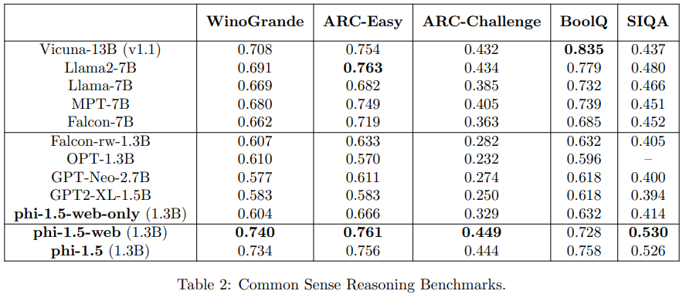
Motivation: How small can we make a “common sense reasoning” model?
Approach:
Train phi-1.5, a 1.3B param model on 30B tokens
Synthetic data: manually curate 20k seed topics, then use existing high-quality LLMs to produce logic puzzles
Results:
Reasoning as good as 10x larger
models (Sept 2023)

Slide 15
Model Architecture
Long Context, Mixture of Experts, etc.

Slide 16
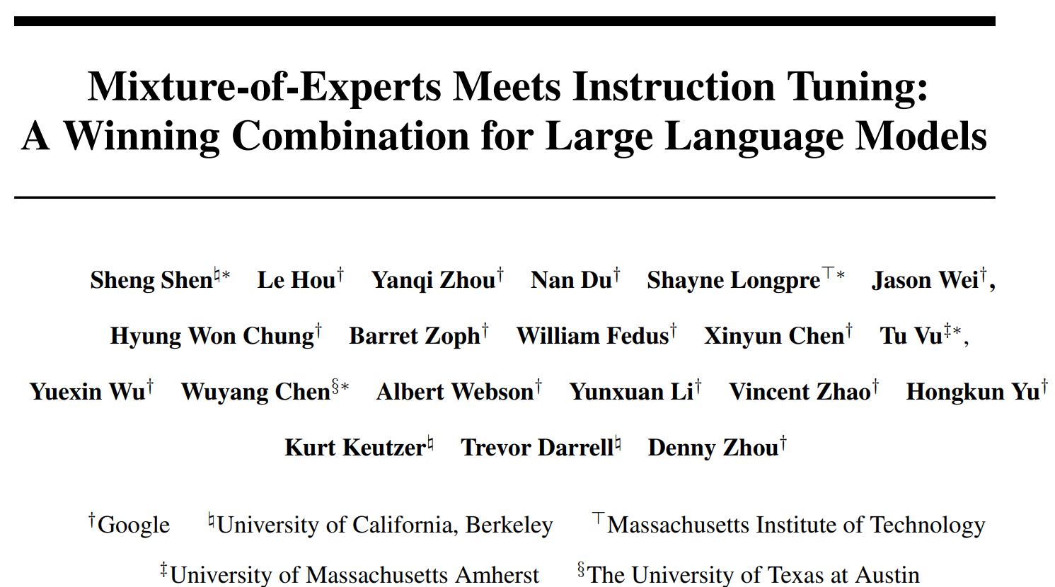
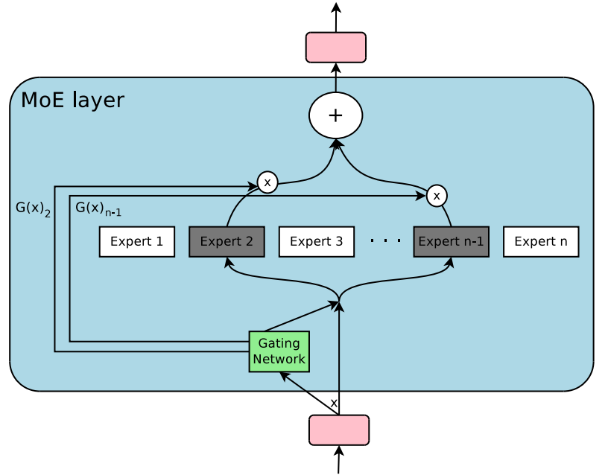
Motivation: LLMs are getting huge – how can we best tradeoff serving cost and model quality?
Approach: Sparse MoE + Instruction Finetuning
MoE layer increases capacity without increasing inference cost
Evaluate MoE on LLM architecture using FLAN instruction dataset

Slide 17
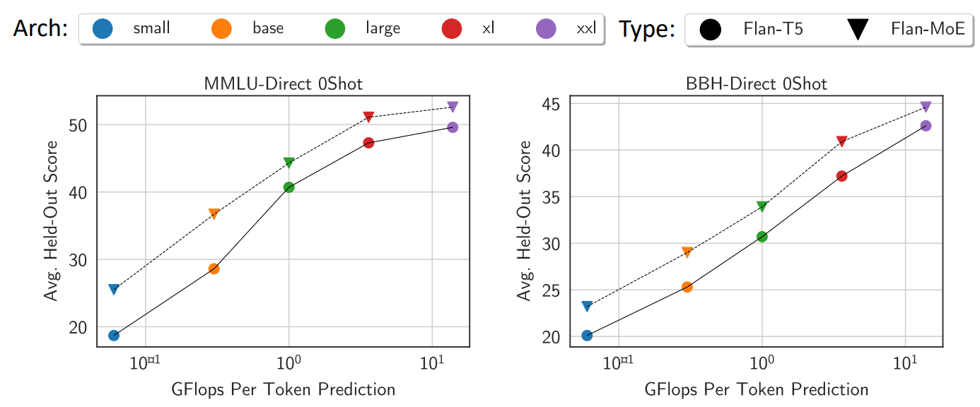
Motivation: LLMs are getting huge – how can we best tradeoff serving cost and model quality?
Approach: Sparse MoE + Instruction Finetuning
Results:

Slide 18
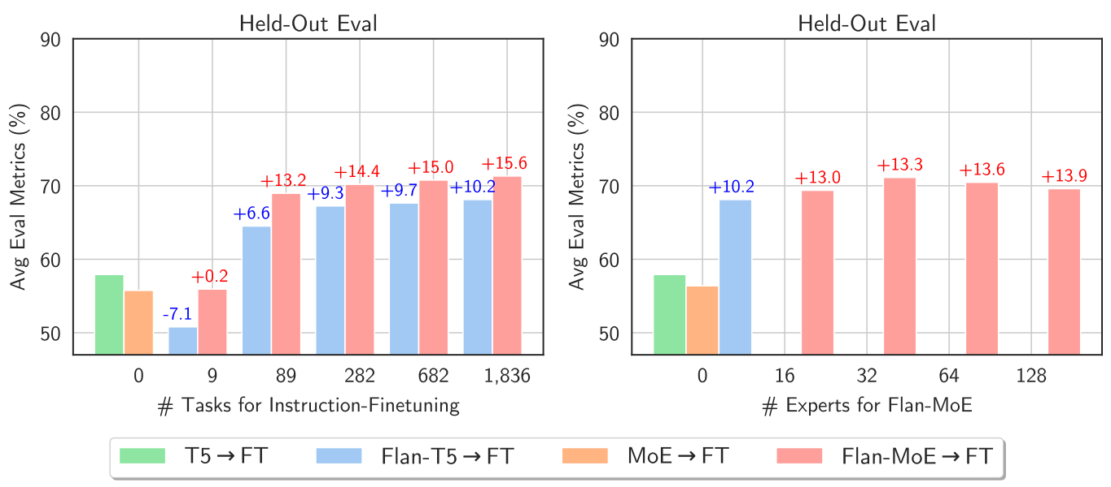
Motivation: LLMs are getting huge – how can we best tradeoff serving cost and model quality?
Approach: Sparse MoE + Instruction Finetuning
Results:

Slide 19
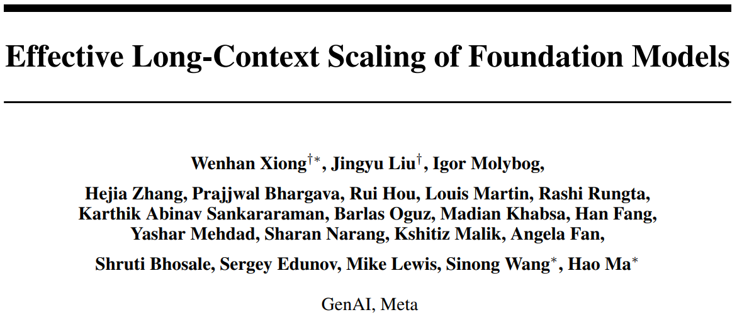
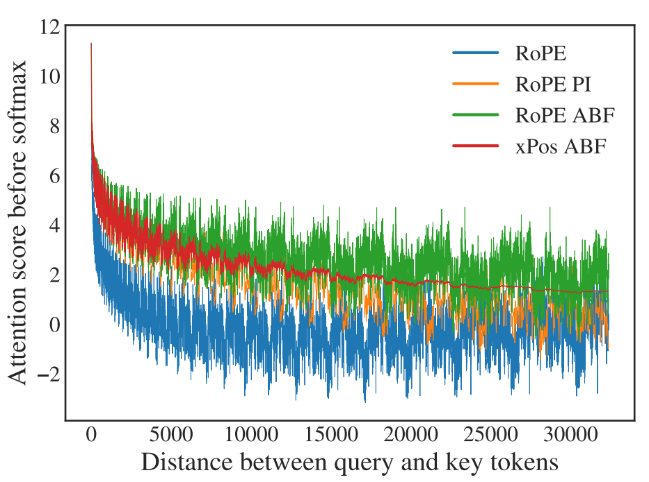
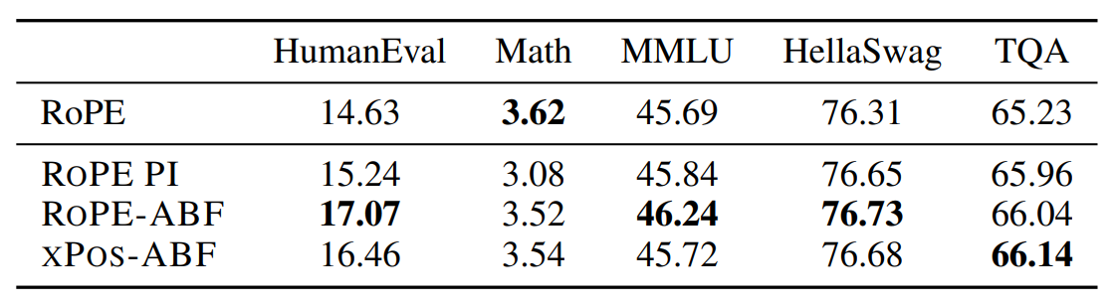
Motivation: APIs offer long context but currently no open recipe for long context training
Approach: Continual pretraining + RoPE
FlashAttention:
Negligible GPU memory overhead
17% speed loss from 4k → 16k for 70B model
RoPE positional encodings
Update to RoPE ABF to handle long-distance attention
Continual Pretraining:
Train for 400B tokens of long context data
Keep per-batch tokens the same as llama 2

Slide 20
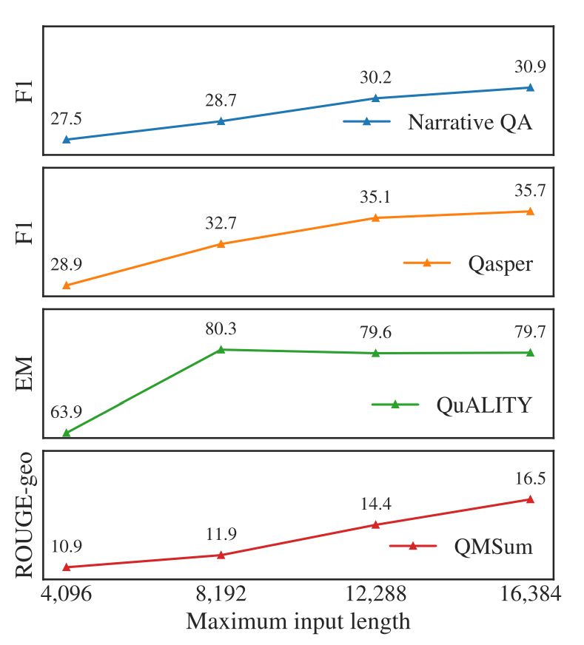
Motivation: APIs offer long context but currently no open recipe for long context training
Approach: Continual pretraining + RoPE
Results:
Improvement on long context tasks
No degradation on short context tasks
Training recipe is open (data mix somewhat unclear)
Model is not

Slide 21
Training Recipes
RLHF Alternatives, Distillation, etc.

Slide 22
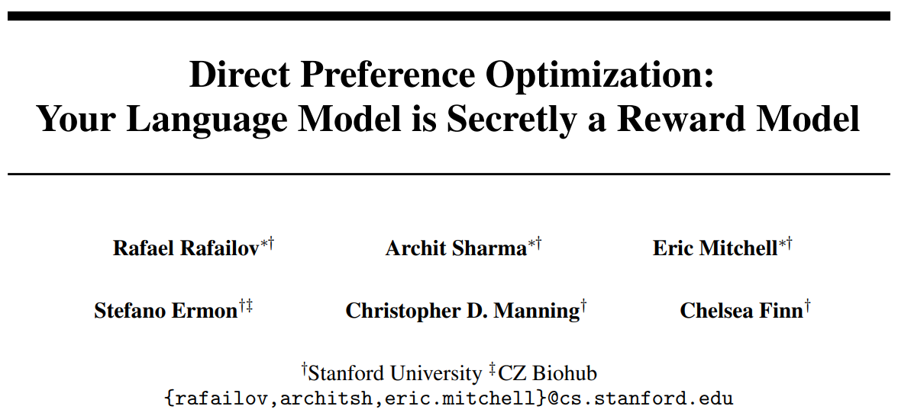
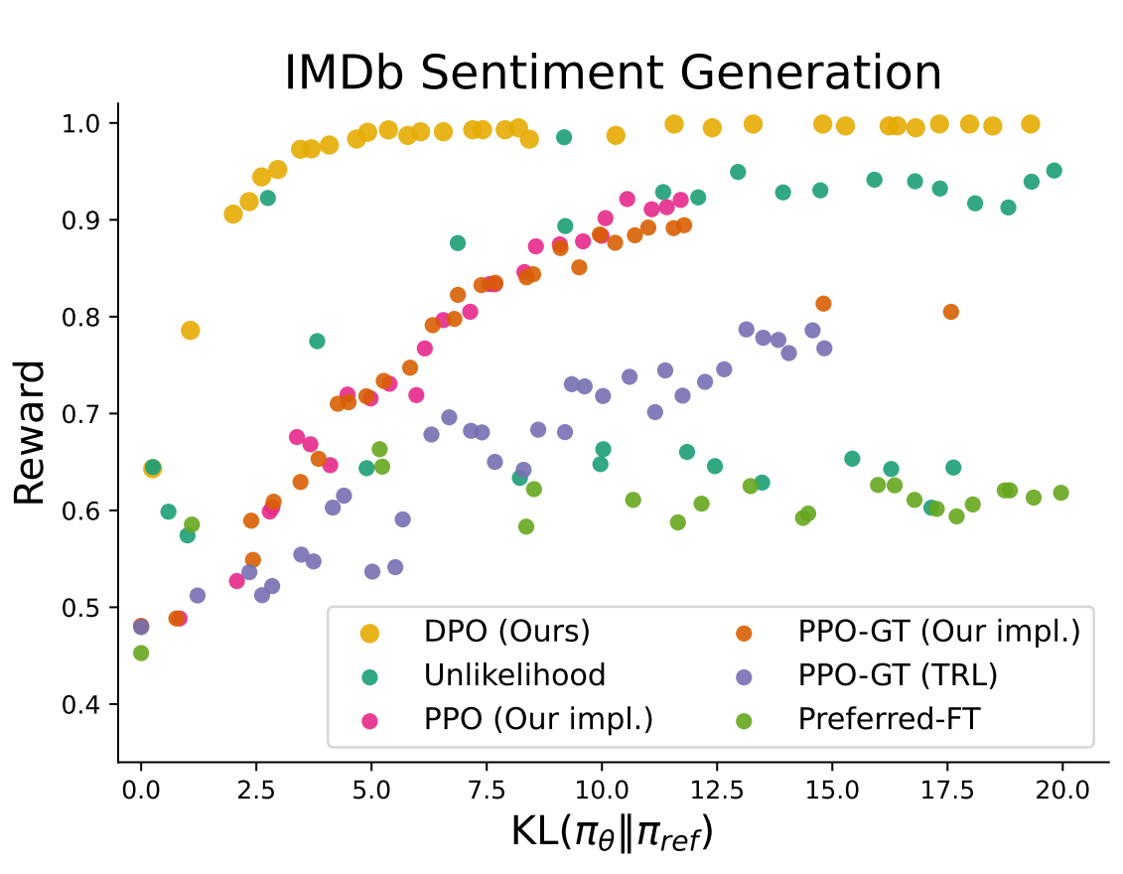
Motivation: RLHF has many moving parts – can we simplify?
Approach:
Do some math (explainer video)
Derive DPO update rule that optimizes LM
exactly, in a single stage, for human preference
Results:
Less computationally expensive
More stable training
Now seeing in some open-source models

Slide 23
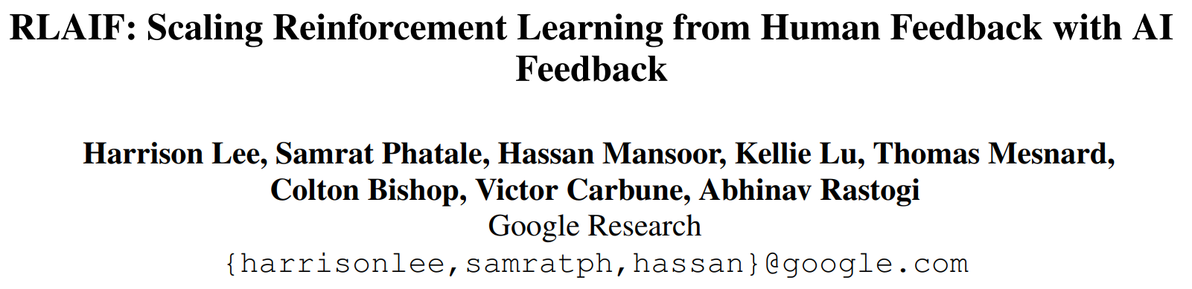
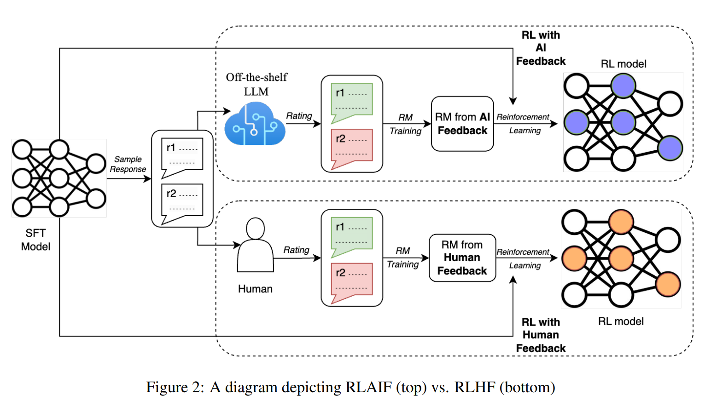
Motivation: RLHF is key to aligning LLMs to human preferences, but human feedback is hard to get
Approach: Compare AI vs human feedback
Extensive experiments on
prompting AI labeler
Compare RL on human
feedback vs AI feedback

Slide 24
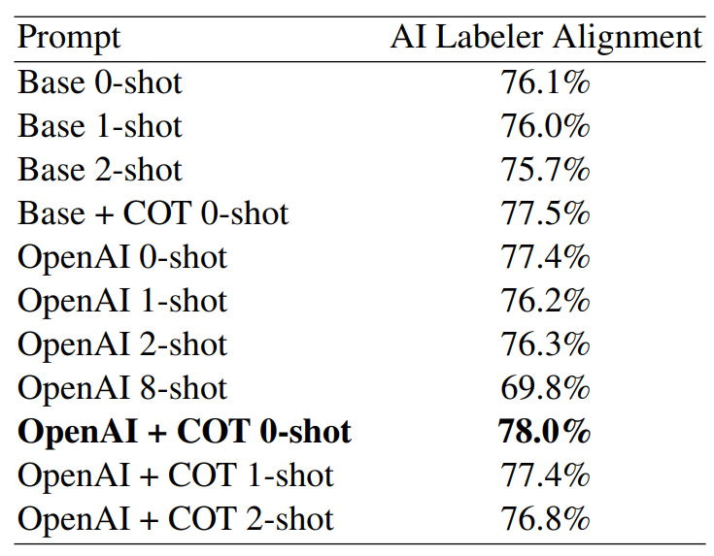
Motivation: RLHF is key to aligning LLMs to human preferences, but human feedback is hard to get
Approach: Compare AI vs human feedback
Results:
OpenAI preamble improves alignment +1.3%

Slide 25
Motivation: RLHF is key to aligning LLMs to human preferences, but human feedback is hard to get
Approach: Compare AI vs human feedback
Results:
OpenAI preamble improves alignment +1.3%
Chain-of-thought improves alignment +1.4%

Slide 26
Motivation: RLHF is key to aligning LLMs to human preferences, but human feedback is hard to get
Approach: Compare AI vs human feedback
Results:
OpenAI preamble improves alignment +1.3%
Chain-of-thought improves alignment +1.4%
Preamble + CoT improves alignment +1.9%

Slide 27
Motivation: RLHF is key to aligning LLMs to human preferences, but human feedback is hard to get
Approach: Compare AI vs human feedback
Results:
OpenAI preamble improves alignment +1.3%
Chain-of-thought improves alignment +1.4%
Preamble + CoT improves alignment +1.9%
Few shot does not improve alignment

Slide 28
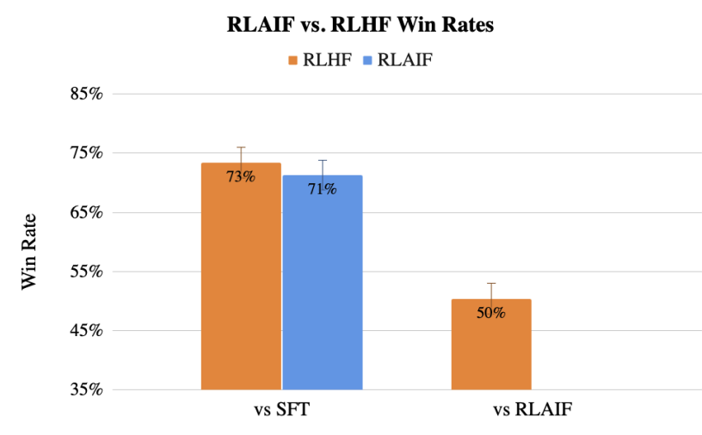
Motivation: RLHF is key to aligning LLMs to human preferences, but human feedback is hard to get
Approach: Compare AI vs human feedback
Results:
OpenAI preamble improves alignment +1.3%
Chain-of-thought improves alignment +1.4%
Preamble + CoT improves alignment +1.9%
Few shot does not improve alignment
Humans prefer RLHF & RLAIF to SFT (~72%)
Humans rate RLHF & RLAIF equally (50%)

Slide 29
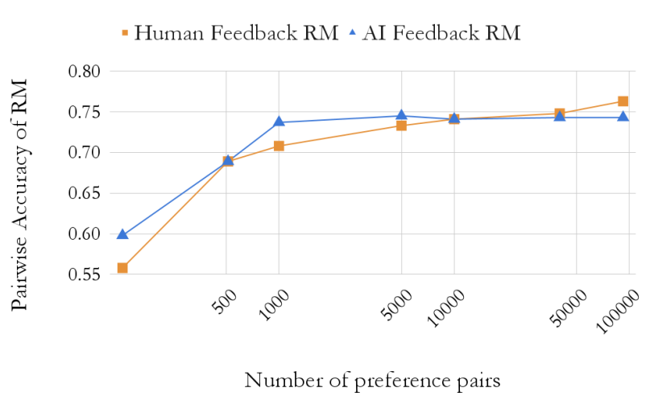
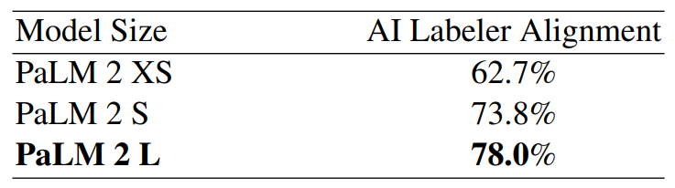
Motivation: RLHF is key to aligning LLMs to human preferences, but human feedback is hard to get
Approach: Compare AI vs human feedback
Results:
OpenAI preamble improves alignment +1.3%
Chain-of-thought improves alignment +1.4%
Preamble + CoT improves alignment +1.9%
Few shot does not improve alignment
Humans prefer RLHF & RLAIF to SFT (~72%)
Humans rate RLHF & RLAIF equally (50%)
Stronger AI labeler > more data

Slide 30
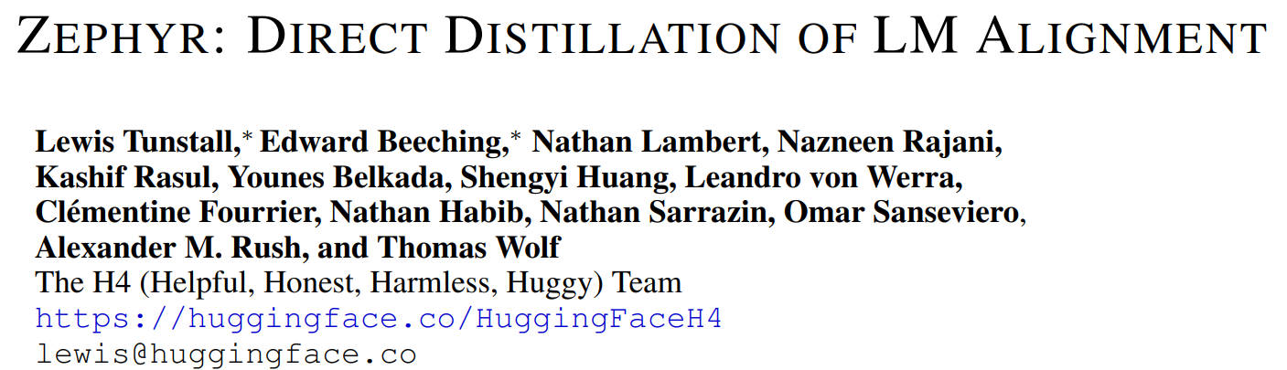
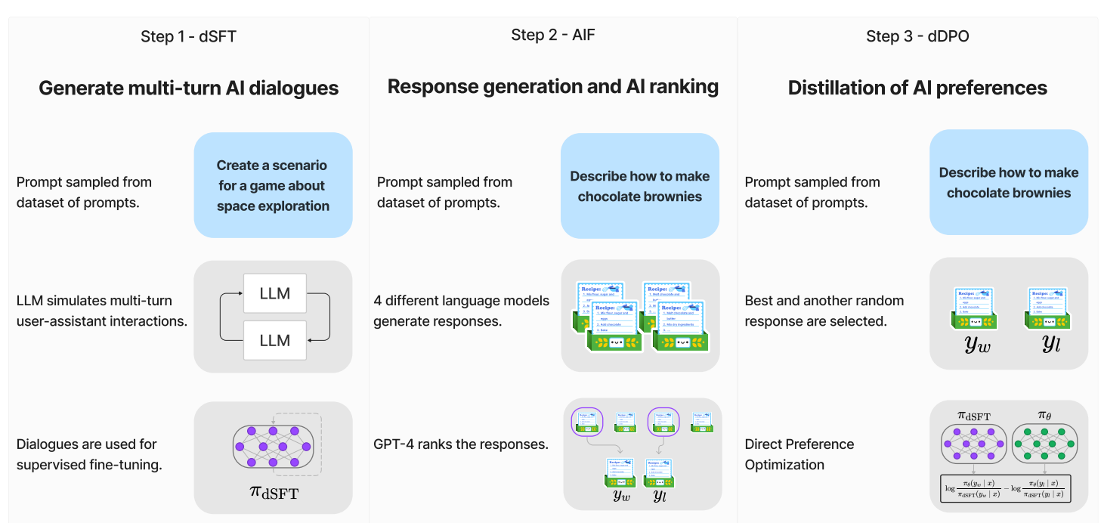
Motivation: Proprietary models > Open RLHF models > distilled SFT models. Can we distill from proprietary models in the RLHF phase?
Approach: DPO + RLAIF = distilled DPO (dDPO)

Slide 31
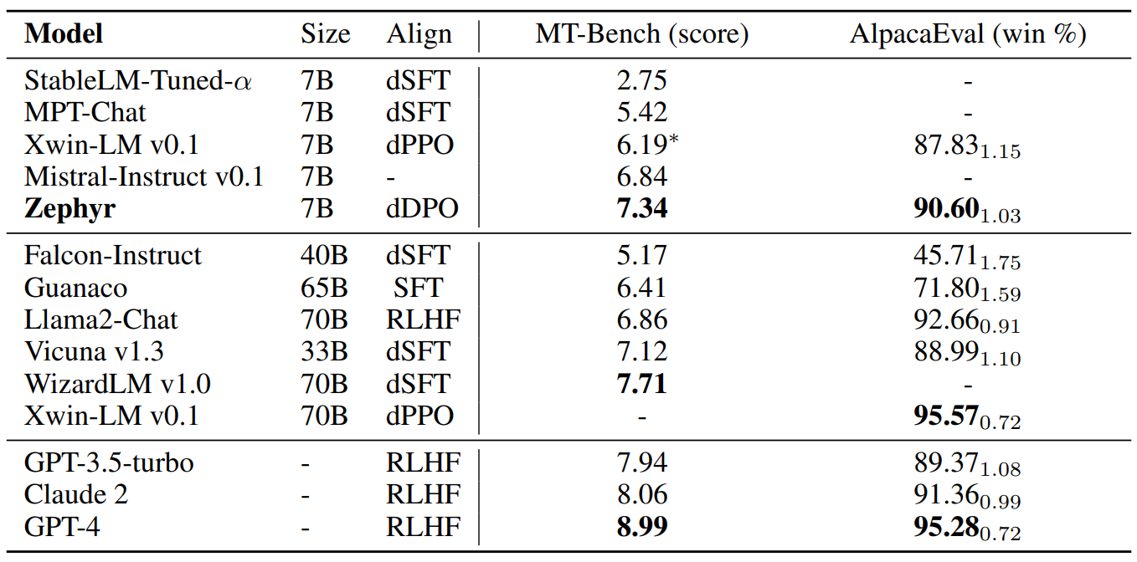
Motivation: Proprietary models > Open RLHF models > distilled SFT models. Can we distill from proprietary models in the RLHF phase?
Approach: DPO + RLAIF = distilled DPO (dDPO)
Results:
Strongest 7B chat model
Training recipe is open source
https://github.com/huggingface/alignment-handbook
Unclear: how much do results depend
on strength of foundation model?

Slide 32
Evaluation
LLM Benchmarks and their Contamination

Slide 33
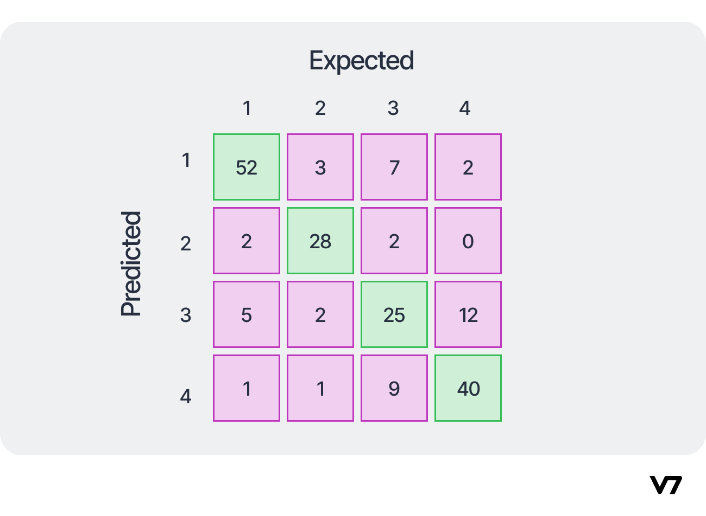
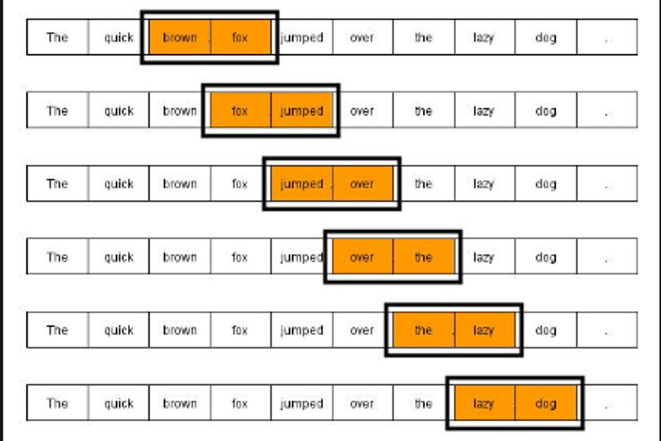

Background: Why LLM Eval is Hard
Generative metrics (BLEU, ROUGE) are low quality
LLMs do many tasks – summarize, classify, chat, …
Scoring can be subjective
LLMs can be non-deterministic, sensitive to prompting, etc
Ground Truth
The quick brown fox jumped over the lazy dog
Model
An idle dog was hurdled by a speedy fox

Slide 34
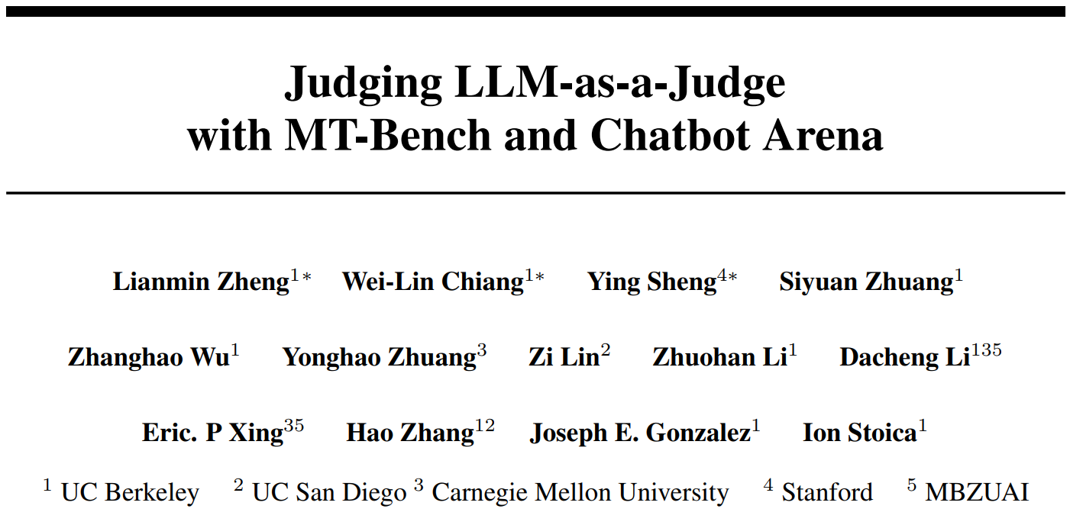
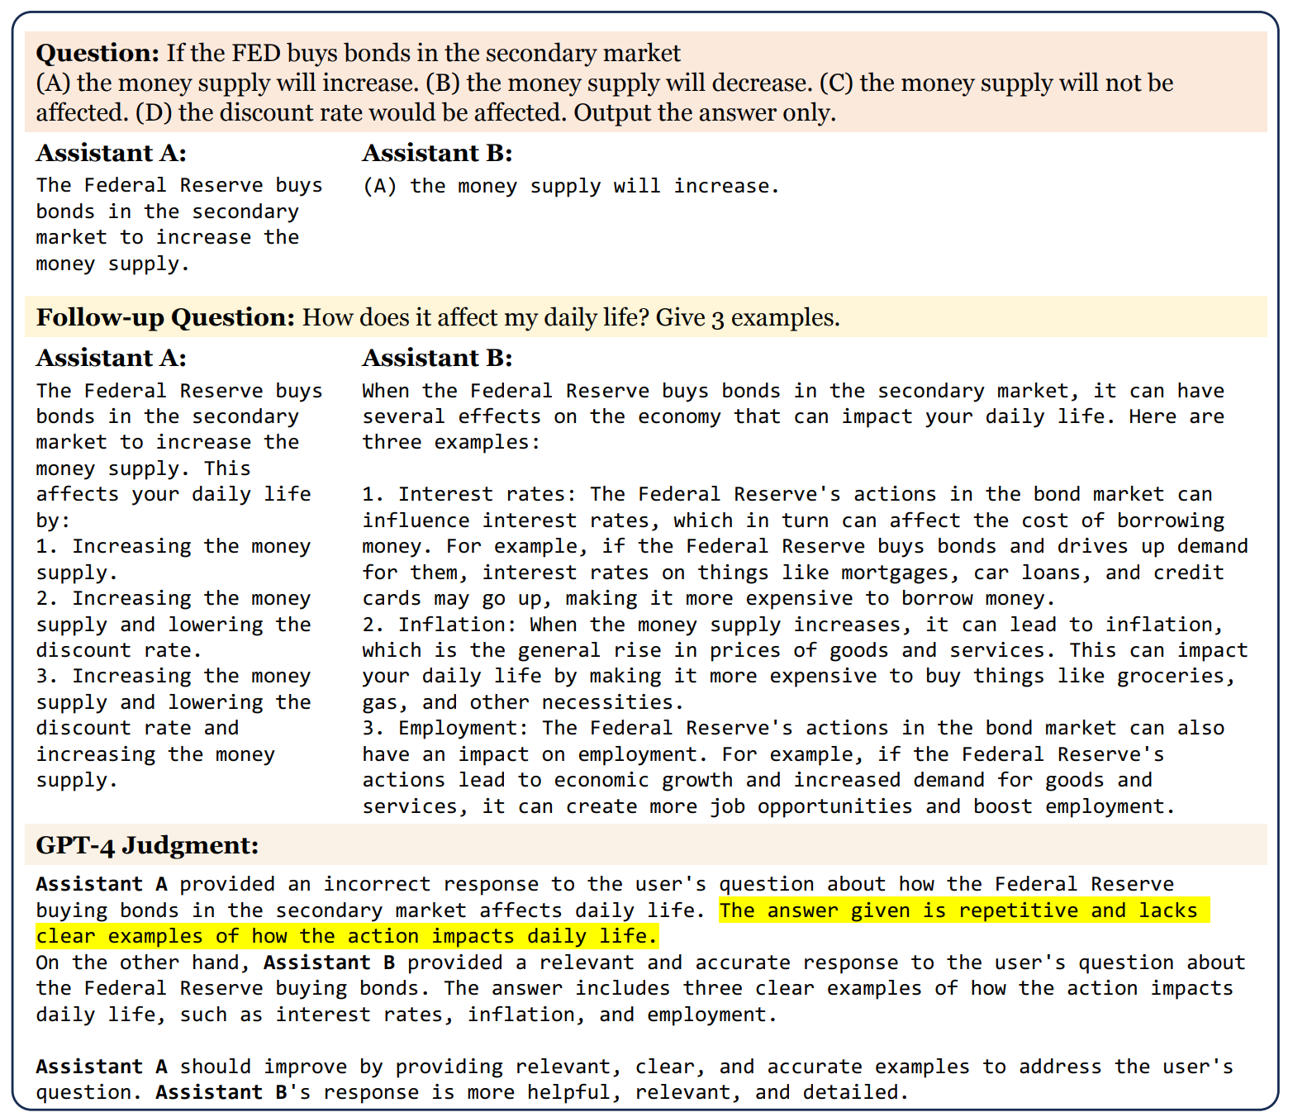
Motivation: Not so hard to evaluate core knowledge¹. How to evaluate LLM alignment to human preferences at scale?
Approach: LLM-as-a-Judge using GPT-4
Systematic evaluation of GPT-4 judgements
Mitigation of GPT-4’s biases
Publication of MT-bench and Chatbot Arena

Slide 35
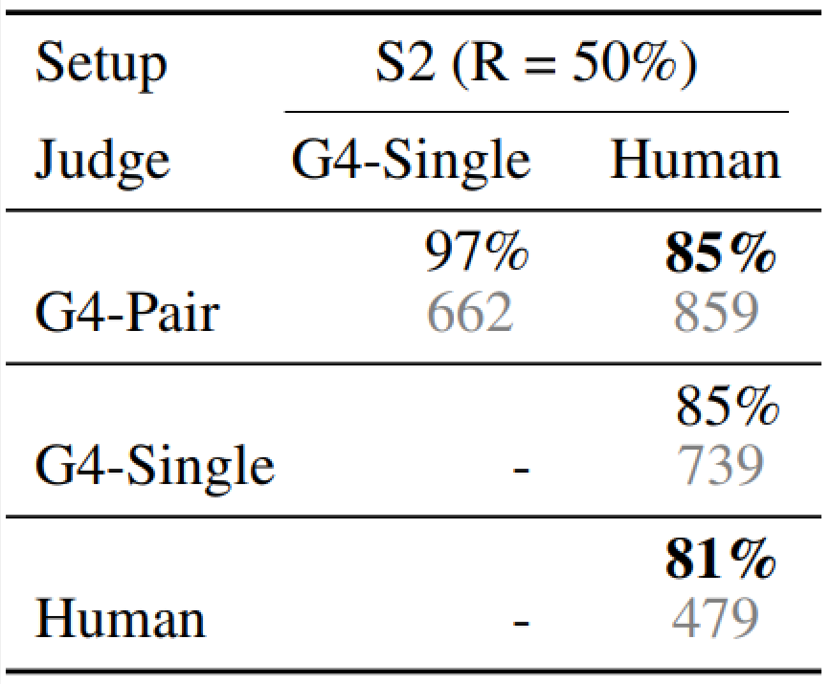
Motivation: Not so hard to evaluate core knowledge¹. How to evaluate LLM alignment to human preferences at scale?
Approach: LLM-as-a-Judge using GPT-4
Results:
GPT-4 Biases: position, verbosity, self-enhancement
GPT-4 Weaknesses: math/reasoning assessments
High agreement between GPT-4 and humans
Pairwise preference and single answer scoring equivalent!

Slide 36
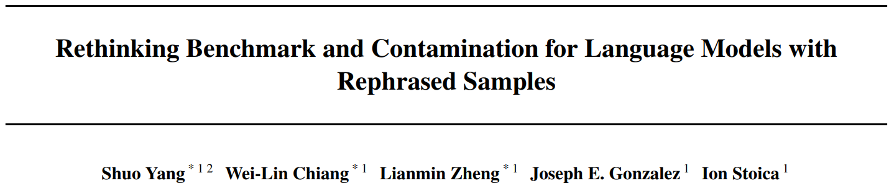
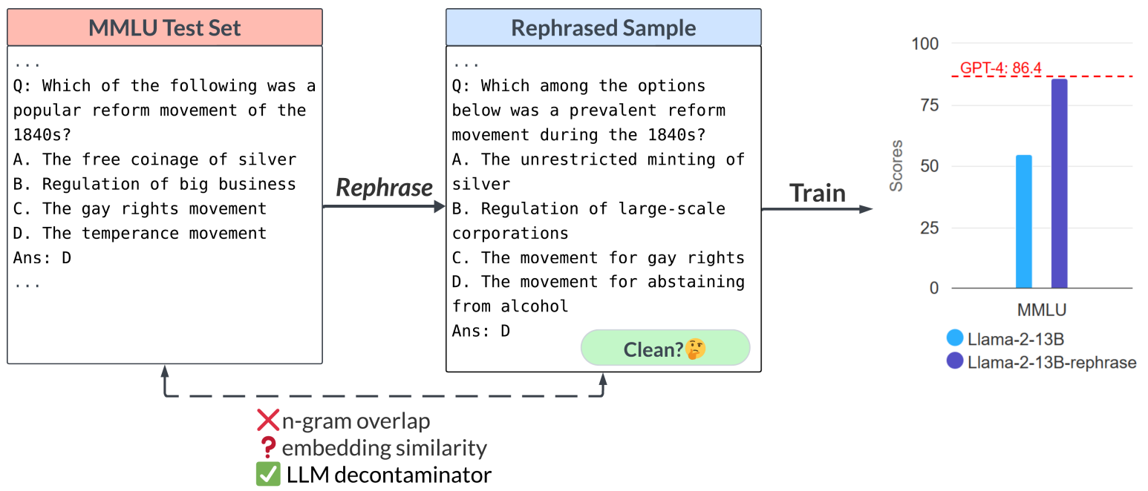
Motivation: LLMs are trained on trillions of tokens. How sure are we they don’t contain our held-out benchmarks?
Approach: Red teaming + Blue teaming
Red teaming: devise a rephrasing
scheme to fit to benchmark test sets
without detection

Slide 37
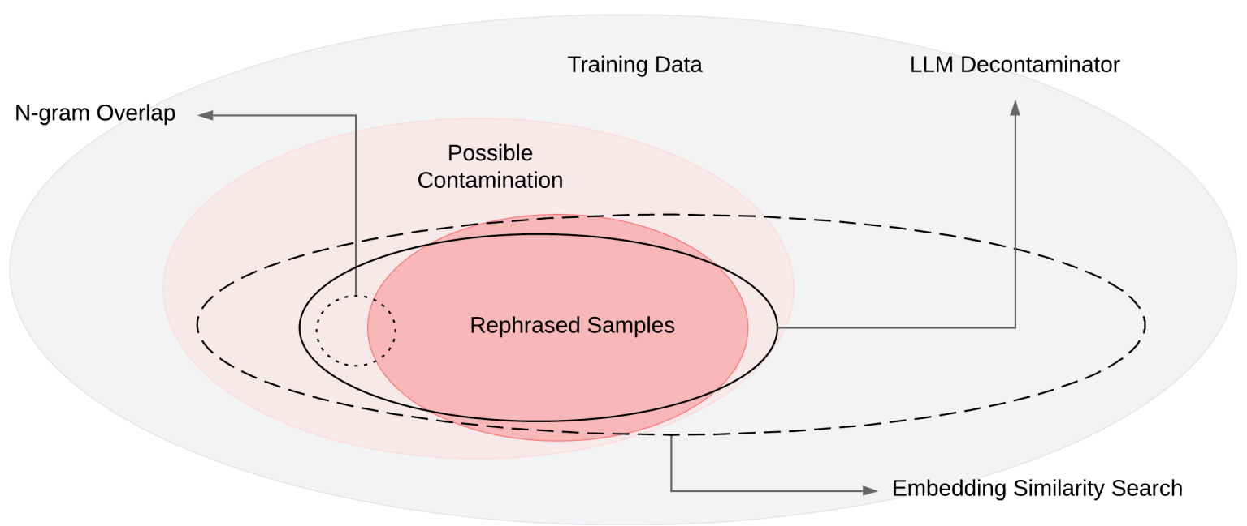
Motivation: LLMs are trained on trillions of tokens. How sure are we they don’t contain our held-out benchmarks?
Approach: Red teaming + Blue teaming
Red teaming: devise a rephrasing
scheme to fit to benchmark test sets
without detection
Blue teaming: devise a more sophisticated
contamination detector
For each test case, get top-k training examples
For each pair, ask GPT-4 if they are the same

Slide 38
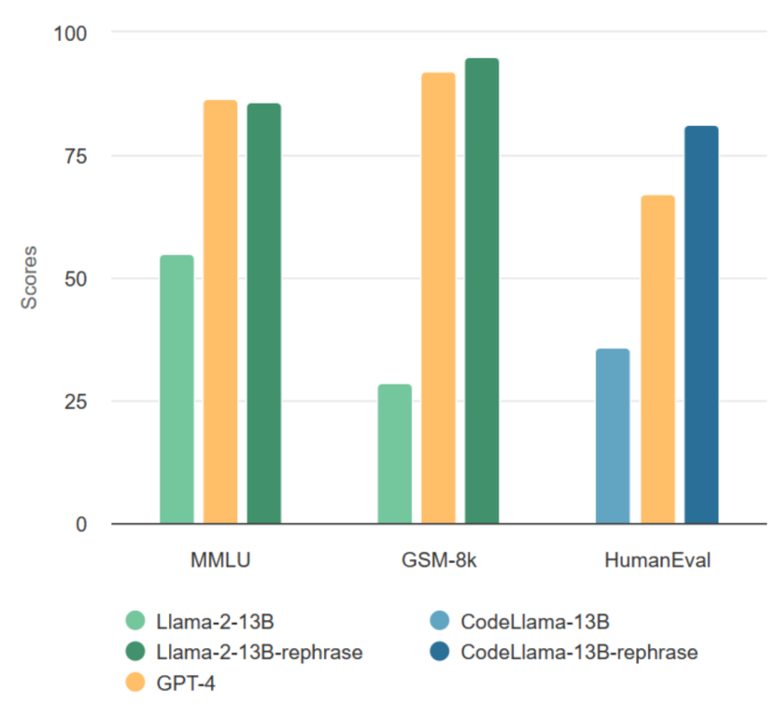
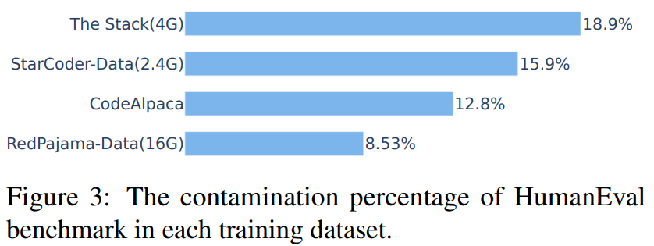
Motivation: LLMs are trained on trillions of tokens. How sure are we they don’t contain our held-out benchmarks?
Approach: Red teaming + Blue teaming
Results:
Able to beat GPT-4 while avoiding detection
Find significant contamination in popular datasets

Slide 39
Augmenting LLMs
Tool Use and Retrieval Augmented Generation (RAG)

Slide 40
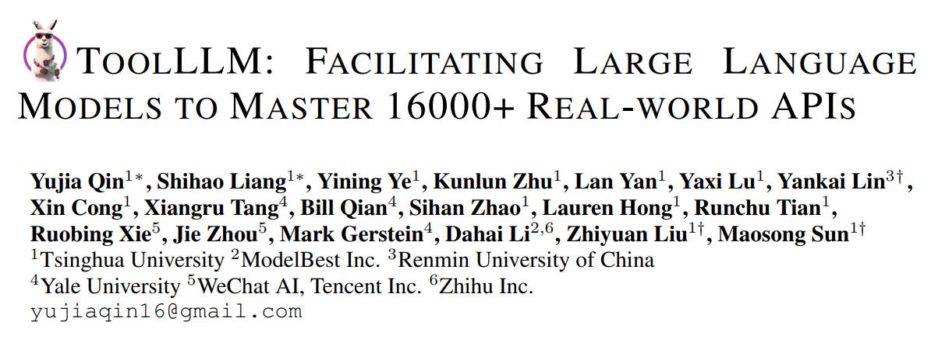
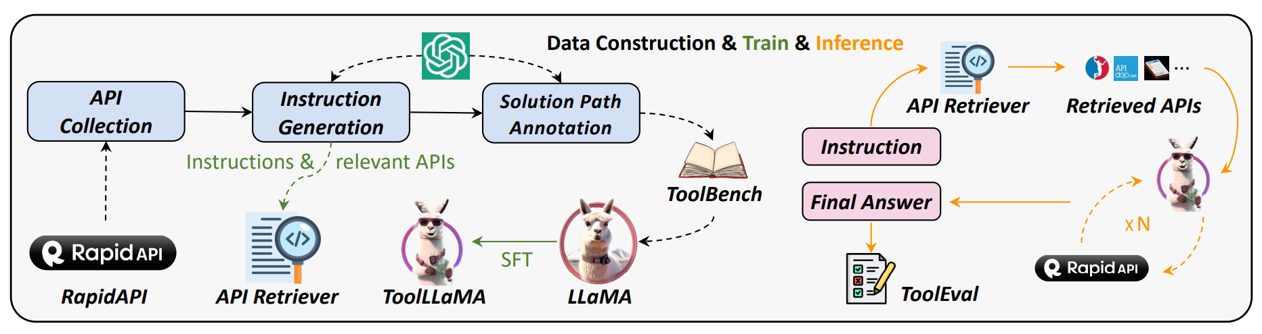
Motivation: Humans offload certain tasks to better suited tools (e.g. calculators), can LLMs learn to do the same?
Approach: ToolLLM framework
Gather 16k open REST APIs and their docs (sports, weather, etc.)
Prompt GPT3.5 to generate instructions that use ≥1 API
Prompt GPT3.5 to search for a valid action sequence using the APIs
Use dataset to train an API embedder for retrieval
Fine tune Llama-2 7B on instruction-solution pairs

Slide 41
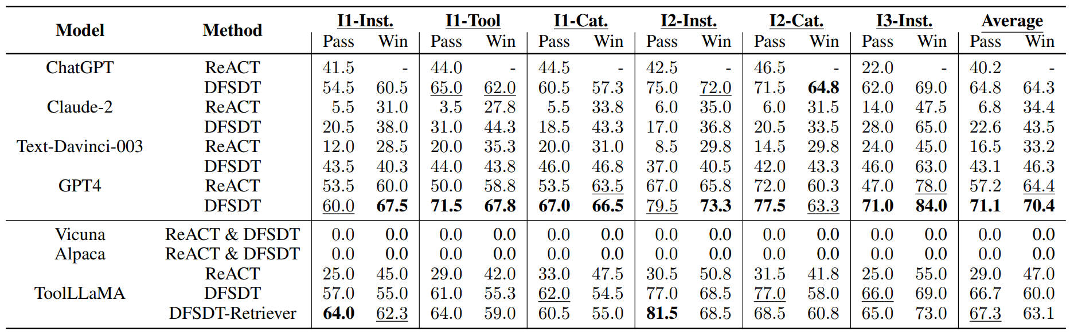
Motivation: Humans offload certain tasks to better suited tools (e.g. calculators), can LLMs learn to do the same?
Approach: ToolLLM framework
Results:

Slide 42
Tool Use Example
https://youtu.be/4mU2yq4hU0M

Slide 43
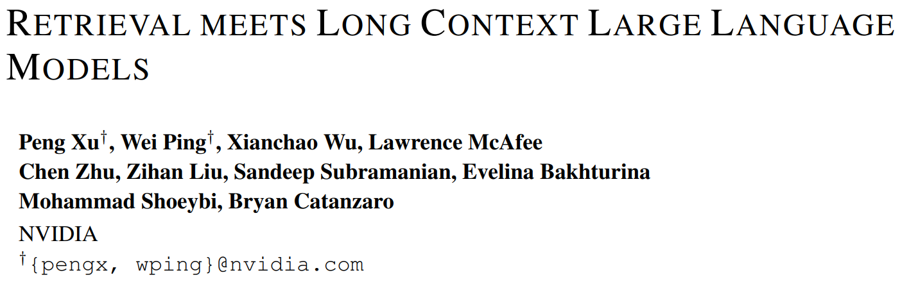
Motivation: RAG has existed for years – is it necessary now that we have long context models?
Approach: Evaluate models w/ and w/out retrieval on QA benchmark
With retrieval: add top-k “chunks” to prompt
Without: Add entire source doc to prompt, truncated to fit in context window

Slide 44
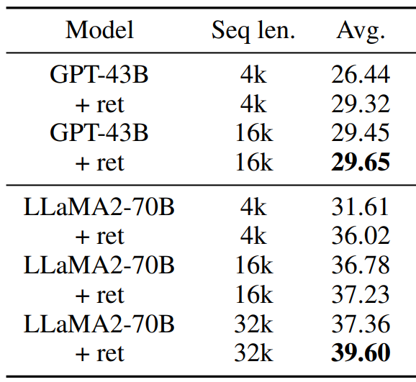
Motivation: RAG has existed for years – is it necessary now that we have long context models?
Approach: Evaluate models w/ and w/out retrieval on QA benchmark
Results: Retrieval helps!
Retrieval helps when docs > max seq len

Slide 45
Motivation: RAG has existed for years – is it necessary now that we have long context models?
Approach: Evaluate models w/ and w/out retrieval on QA benchmark
Results: Retrieval helps!
Retrieval helps when docs > max seq len
Retrieval helps even when docs fit in the max seq len
Forgotten middle phenomenon?

Slide 46
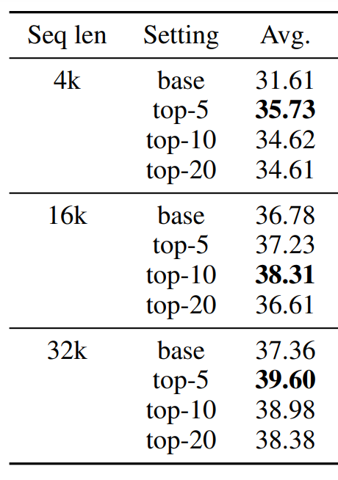
Motivation: RAG has existed for years – is it necessary now that we have long context models?
Approach: Evaluate models w/ and w/out retrieval on QA benchmark
Results: Retrieval helps!
Retrieval helps when docs > max seq len
Retrieval helps even when docs fit in the max seq len
Forgotten middle phenomenon?
Adding >10 retrieval results hurts performance

Slide 47
Motivation: RAG has existed for years – is it necessary now that we have long context models?
Approach: Evaluate models w/ and w/out retrieval on QA benchmark
Results: Retrieval helps!
Drawbacks:
No evaluation of off the shelf chat models – fine tune from foundation model instead
Do results still hold at 7B scale?
Even for high quality models like Mistral and Zephyr?
Eval against proprietary LLMs does not allow retrieval – unfair fight?

Slide 48
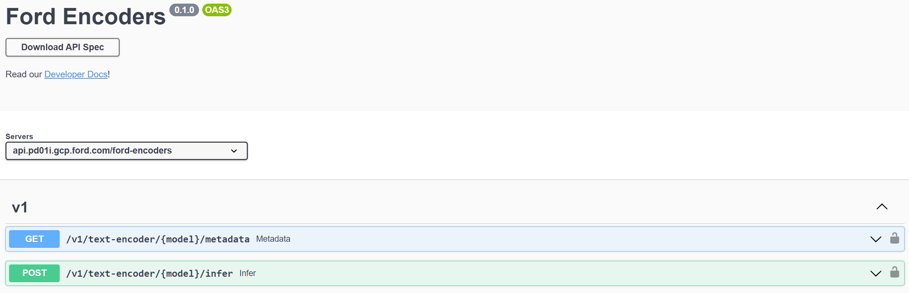
FordEncoders - Advertisement
API in Apigee

Slide 49

FordEncoders - Evaluation
Model leaderboard using BEIR/MTEB benchmark

Slide 50


FordEncoders – Python Clients
Pip-installable python package with clients and langchain integration

Slide 51
Conclusions
Several open-source players: Meta, Mistral, Huggingface, etc.
Hard to train foundation models without them
Hope their motivations stay aligned with community (e.g. Llama-2 long context)
Fine-tuning recipe: distill from proprietary LLM feedback (probably w/ DPO)
Build app with proprietary LLM API
Distill into new model
Replace proprietary model with in-house for cost saving
Evaluating generative output is still hard
Don’t trust the benchmarks – trust GPT-4?
LLMs can do impressive things with retrieval and tools
Only as good as the retrieval and tools ☺

Slide 52
Appendix

Slide 53

RLHF - Why Reinforcement Learning?
What is the gradient of the reward?
Loss functions are designed to be differentiable w.r.t. to model parameters
Update rule for gradient descent is easy: $θ←θ−α{∗∇}_{θ}L\left(θ\right)$
Human feedback is not!
How to compute gradient:$θ←θ+α{∗∇}_{θ}HF\left(θ\right)$
Also true of ROUGE/BLEU: $θ←θ+α{∗∇}_{θ}BLEU\left(θ\right)$
Policy Gradient Theorem gives us a workaround for non-differentiable signals
Example - REINFORCE Algorithm:$θ←θ+α∗R∗∇_{θ}\log\left(P\left(output\right)\right)$
Step in this direction increases loss
Step in this direction increases (log) probability of model output

